Slide 1
Machine Learning for Medical Image Analysis
By
Faiza Anan Noor

Slide 2

About Me
Faiza Anan Noor
Adjunct Lecturer of Computer Science and Engineering(CSE)
at Ahsanullah University of Science and Technology(AUST)
BSc in CSE from AUST

Slide 3
What is Machine Learning?
Artificial Intelligence(AI)
enables computers to mimic human behaviour
Machine learning(ML), a subset of AI, enables systems to learn and improve from experience without being explicitly programmed.
Machine Learning uses data and algorithms to imitate the way that humans learn, gradually improving its accuracy.
Deep learning(DL), a subset of ML,
extracts patterns from data using neural networks

Slide 4
Some Machine Learning Applications
in the Medical Field
Medical Image Classification
Labeling images based on their features
For decision-making in pharmaceutical data
Drug Discovery
Segmentation or Localization
Segmentation/localiza--tion of image portions
Diagnosing diseases based on symptoms in input data
Medical Diagnosis

Slide 5
History of Machine Learning in
Medical Image Analysis
Initial Phase
End of 1990s
Low level pixel processing &
Mathematical Modelling were used
Traditional machine learning methods
such as Supervised techniques were used.
Features were extracted and passed to the system
Final Phase
Deep Learning methods, such as convolutional neural networks
are used nowadays

Slide 6
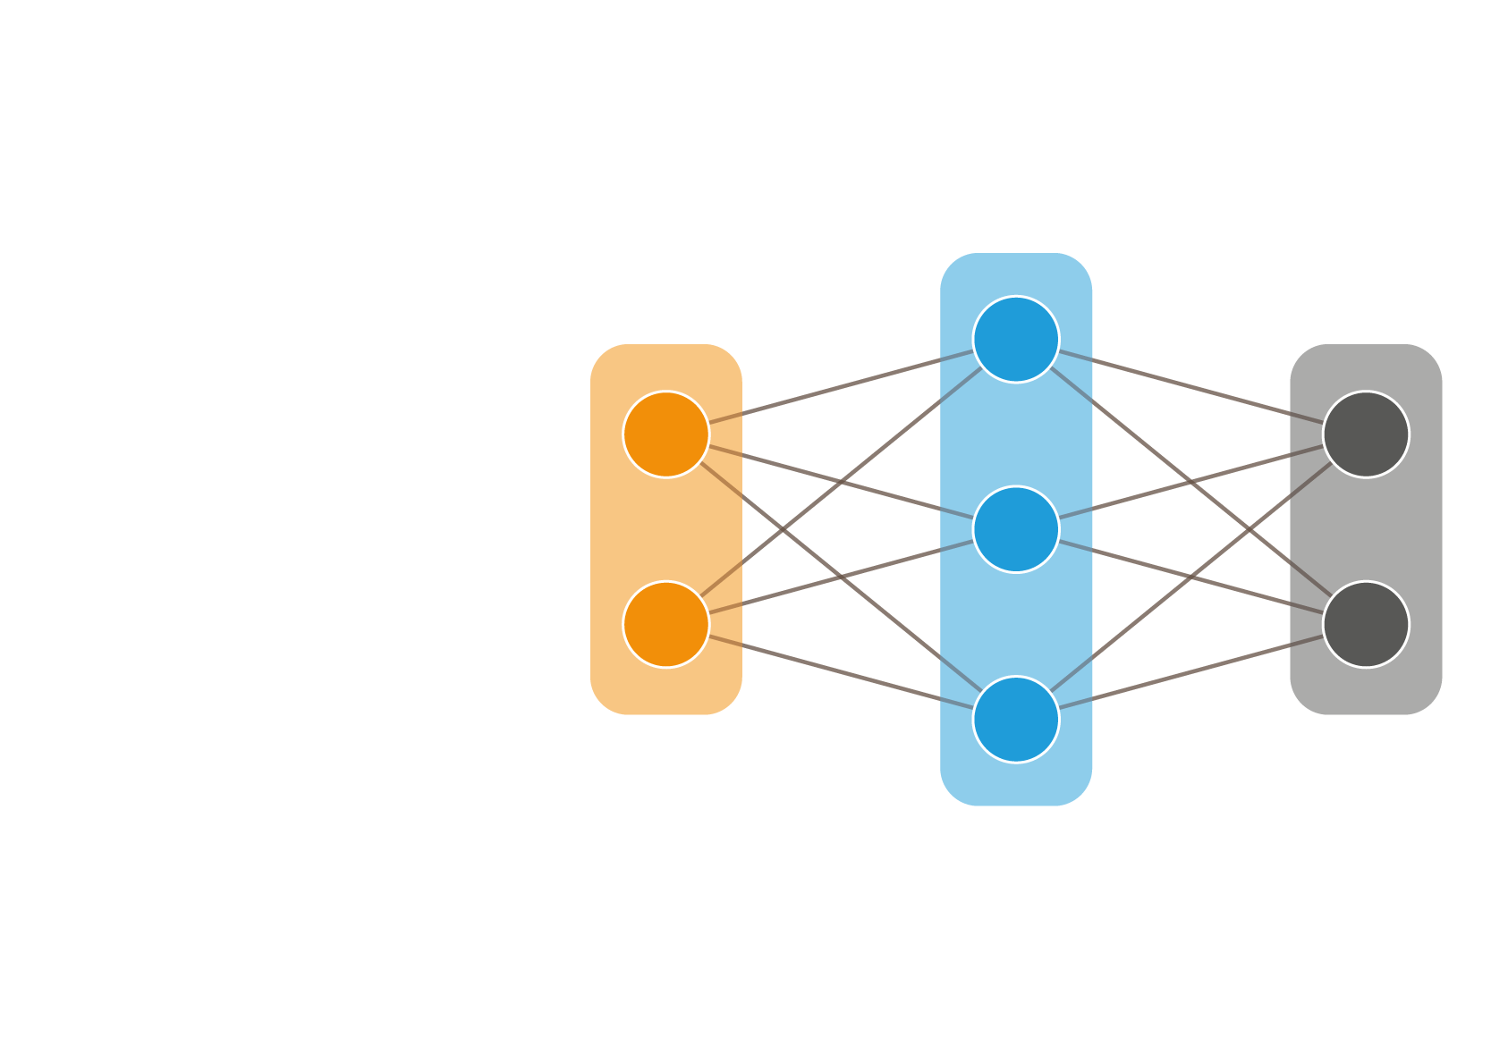
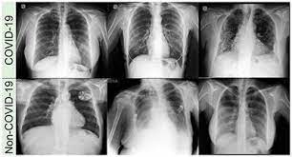
Traditional Machine Learning
for Medical Image analysis
Pixel classification with features computed from the image patch
Reticular interstitial thickness,
Consolidation,
Pleural effusion
Classification
Feature engineering
Input image

Slide 7
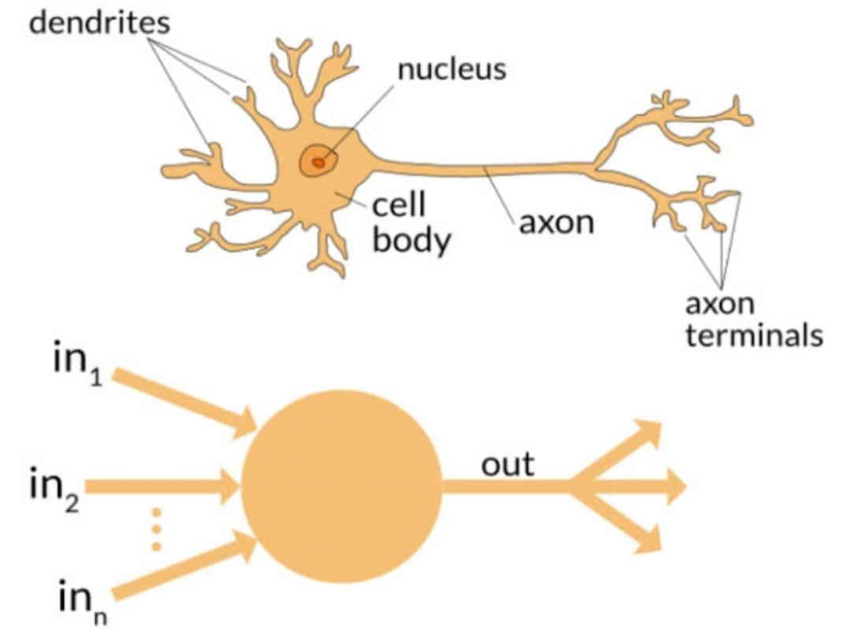
The Deep Learning Principle
What is Deep Learning(DL)?
Deep Learning(DL) is subset of machine learning(ML), which is essentially a neural network with three or more layers.
These neural networks attempt to simulate the behavior of the human brain.
Neural networks are layers of nodes, just like how the
Human brain is made up of neurons.

Slide 8
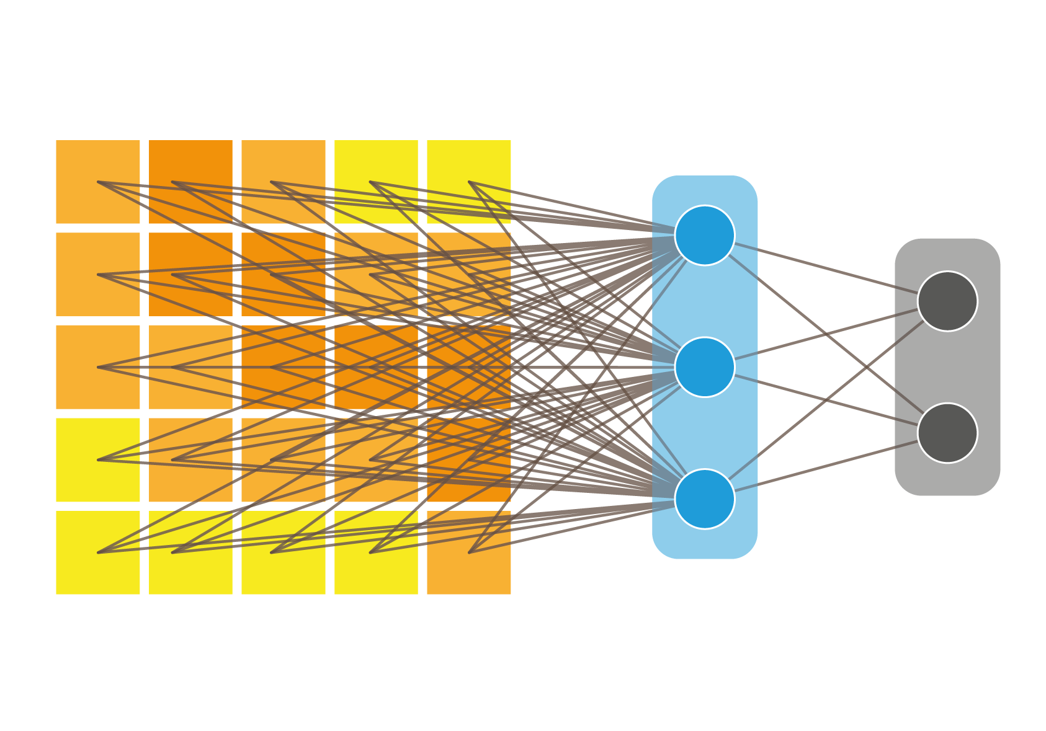
The Deep Learning Principle
Classifier itself learns meaningful representations from the raw pixel values of input data
Input image
Classification
Raw pixels

Slide 9

How does the network predict?
It predicts using the loss/error between the predicted labels and reference labels(outputs) and by calculation using its parameters and input values from each layer
0.25
0.0
(Non Covid)
Loss
1.0 (Covid)
0.75
Predicted labels
Reference labels
Forward pass

Slide 10

How does the network learn?
It learns by updating its parameters, after getting the value of the deviation of output value to true value
Backward
pass
Reference
0.25
0.0
Loss
0.75
1.0

Slide 11
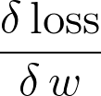
How does the network learn?
Contribution of
weight w to loss
=
Reference
0.25
0.0
Loss
0.75
1.0

Slide 12
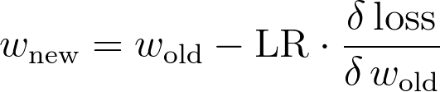
How does the network learn?
Update rule:
Reference
0.25
Loss
0.0
0.75
1.0

Slide 13
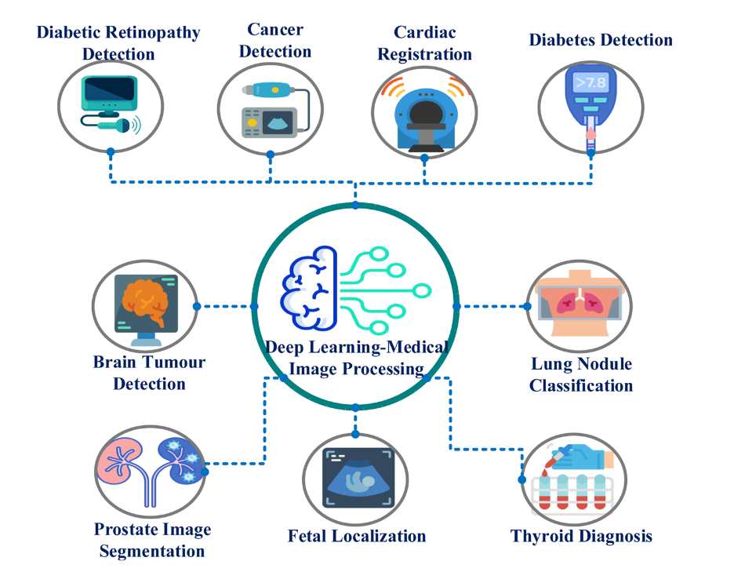
Applications of Deep Learning
in Medical Image analysis

Slide 14
Advantage and Disadvantage of Deep Learning
Pros:
High learning capacity of patterns or trends
Adapts to various input types
Huge scopes in other fields
Cons:
Prone to overfitting
Needs huge amount of data
Invariance must be learned

Slide 15
Thank you
Any questions?

